Slide 1
CS422 Database systems
Data warehouses and Decision Support Systems
Data-Intensive Applications and Systems (DIAS) Laboratory École Polytechnique Fédérale de Lausanne
“He uses statistics as a drunken man uses lampposts - for support rather than for illumination.” – Andrew Lang
Notes:
Add Ron Fagin’s top-k stuff?
In previous lectures we discussed the techniques how a database system executes queries (initially how data is stored then how the query is translated into a physical execution plan and last week we discussed how a query is optimized
so that the systems chooses the best plan.
This week however we will discuss something that depending on your career choices, some of you may actually use in your everyday lives.
And that is how database systems act as the data warehouses and as the back-end for decision support systems.

Slide 2
Overview
Introduction
Data warehouses
On-line analytical processing (OLAP)
Views
Top-N queries
Notes:
Initially we will discuss what is a data warehouse we will discuss what are data analytics and subsequently we will finish this lecture by presenting specialized queries and techniques which enable support for data analytics.

Slide 3
Introduction
On-Line Transaction Processing: OLTP
Updates and queries involving few tuples
Register a purchase, read/update the clients’ balance, …
Dynamic data, exact results required
DBA/developer knows exactly what to ask for
Decision support systems (DSS)
Long-running queries over (almost) all data
Get interesting insights from the data:
E.g., smoking causes cancer, more toys sold near xmas
Fairly static data
Exploratory process – ad-hoc queries
Notes:
OLTP: traditional databases. Typically small queries and updates that are executed almost instantaneously. User requirements are typically clear. DBA knows exactly how to describe the queries/updates! There is no guessing going on!
Decision support systems are for helping users to take the right decisions. User needs are not so clear in this case. Queries that take longer to run, typically go through a lot of data, potentially all data in a table! These queries are exploratory queries, and they are useful for getting insights. Also, typically, these queries are ad-hoc. User not aware on what exactly he is looking for. He is trying to get a feeling of the data, to understand it, to find relations and correlations, to get insights out of the data.
Example:
Have data from many patients, try to extract causal relations, e.g., smoking causes cancer.
DSS in a supermarket: How to arrange the store so that clients shop more? Which categories of products are highly profitable? Which categories of products should we advertise?

Slide 4
Introduction (2)
Three complementary trends
Data warehousing
Consolidate data from many sources in one large repository
On-Line Analytic Processing (OLAP)
Complex SQL queries and views
Aggregates and group bys
Data mining (not in this course)
Clustering, classification, decision trees, …
Notes:
Decision support systems include three complementary trends!
Data warehousing concerns storage and data consolidation.
OLAP is about querying these data. Queries can again be expressed in SQL, but these are not typical queries. Each query typically touches all data! Queries are also arbitrarily complex – many selections, many aggregates, many group bys.
Data mining important, but not in this course.

Slide 5
Overview
Introduction
Data warehouses
On-line analytical processing (OLAP)
Views
Top-N queries

Slide 6
Data Warehousing
External data sources
Integrated data spanning long time periods
Mostly static – ad-hoc updates uncommon
Complex ad-hoc queries, interactive response times!
Extract
Transform
Load/refresh
Data warehouse
Metadata
SUPPORTS
OLAP
Data
mining
Complex
queries
Visualizations
Notes:
First trend: Data warehousing
Decision support systems rely on typically a great volume of historical data → need to integrate a lot of data that typically spans long time periods.
Data is mostly static! Few updates, mostly reads. In fact, ETL process to handle updates, typically periodically. It is not as simple as running an SQL command – this is not a traditional database update.
Queries are of different types. More complex, but still require interactive response times, because a user/scientist/doctor is sitting in front of a computer, waiting to get useful information that will lead her to a decision! Taking too long will: a) increase hardware cost, b) keep the analyst waiting.
Data warehouse itself can be built on top of a relational database, e.g., Oracle.

Slide 7
Warehousing issues
Semantic integration: Normalize data from multiple sources, eliminate mismatches
Heterogeneous sources: Access data from different source formats and repositories
Load, Refresh, Purge cycle: Load data, periodically refresh it, purge old data
Metadata management: Keep track of sources and metadata (e.g., loading time, format, transformations)
Notes:
Main challenges in data warehouses:
Semantic integration: Too many data sources, noisy, not necessarily from within the same department/company. Example: Some data may come from company records (operational database), some other may be bought from data markets, from browser cookies, or from web crawls. Need to normalize data from different sources, match records that refer to the same entities together, find duplicates, eliminate mismatches.
Heterogeneous sources, different formats, different storage.
Handling new data: Updates typically not real-time, not adhoc. But eventually need to load/incorporate the new updates from the operational databases. How do we locate these updates?
Metadata: complex process. Need to keep a lot of metadata that will enable us just to run this process.

Slide 8
Warehousing issues (2)
Querying
Huge data
Scan-intensive queries, touch (almost) all data
Exploratory, ad-hoc queries
Difficult to describe
Difficult to optimize
Notes:
Final challenge - what we will look into today:
- Querying. Different than traditional OLTP queries
We typically have huge data. Queries touch almost all data.
They are exploratory queries, ad-hoc. A data analyst, a scientist, does not know WHAT he needs to ask for. He will just start exploring the data space, looking for interesting conclusions that can be profitable for the company. → difficult to describe these queries, and difficult to optimize for these queries as well.

Slide 9
Overview
Introduction
Data warehouses
On-line analytical processing (OLAP)
Views
Top-N queries
Notes:
Precisely for this last problem, for querying, we have OLAP: Online analytical processing. A query language (extension of SQL) and a set of tools that are suitable and developed to extract insights from data warehouses

Slide 10
Multidimensional data model
Numeric measures which depend on a set of dimensions
Measure Sales, dimensions Product, Location, Time
Prodid | Timeid | Locid | Sales
11 | 1 | 1 | 3
11 | 2 | 1 | 4
12 | 1 | 1 | 15
12 | 2 | 1 | 30
13 | 1 | 1 | 20
13 | 2 | 1 | 20
11 | 1 | 2 | 33
11 | 2 | 2 | 31
…
Slice for
locid=1:
3 | 4
15 | 30
20 | 20
11
12
13
1 2
Prodid
Locid
Timeid
Store as array (MOLAP) or relations (ROLAP)
Notes:
Data that we consider is by definition multidimensional. Here we see the #sales of each product for each time id, and for each store (location id).
User is interested to get insights from this multi-dimensional data. A possible insight would be that, the product with product id 11 is not very popular in location with id 1.
The problem is that this data here is too detailed → practically useless for the purpose of getting insights, and will take a lot of time for an analyst to go over it. Think that we may have millions and millions of such tuples.
We instead need aggregates, e.g., sums of sales for each product, for a particular time, or even for a period of time. In this example, we see a slice of data for a particular location. This is aggregate information

Slide 11
ROLAP: Relational OLAP
Store multi-dimensional data as relations in a star schema:
Fact table: Huge, stores the measurements/facts
Normalized
Dimension tables
Denormalized
In this example,
Quantity and TotalPrice are the only measures!
Notes:
Data can be stored as relations, e.g., in a relational database. → we can reuse a lot of technological advances!
Typically we follow star schema.
Fact table, that stores the actions, measurements, facts. In previous example, fact table stored the sales.
Dimension tables store additional details about the information summarized in the fact table.
Fact table is the most interesting one. Typically huge and dynamic. This is what we want to compute aggregates on. Dimension tables can also be large, but typically much smaller. Also mostly static. Example: how frequently will we be adding a location, i.e., opening a new store? How frequently we will need to add a record in sales.
When we use relational databases as the backbone, we call it ROLAP.

Slide 12
Star schema example
Prodid | Timeid | Locid | Sales
11 | 1 | 1 | 25
11 | 2 | 1 | 8
12 | 1 | 1 | 15
12 | 2 | 1 | 30
13 | 1 | 1 | 20
13 | 2 | 1 | 20
11 | 1 | 2 | 33
11 | 2 | 2 | 31
…
Multi-dimensional data stored as relations
Fact table
Dimension tables
Prod id | name | Category | Price
1 | Lee jeans | Apparel | 25
2 | Zord | Toys | 18
3 | Biro pen | Stationery | 2
…
Locid | City | State | Country
1 | Ames | Iowa | USA
2 | Chennai | TN | India
3 | London | - | London
…
Time id | date | week | month | quarter | year | holiday flag
1 | 01.01.17 | 1 | 1 | 1 | 2017 | T
2 | 02.01.17 | 1 | 1 | 1 | 2017 | F
3 | 03.01.17 | 1 | 1 | 1 | 2017 | F
…
Notes:
Fact table stores the data that we are interested in analyzing, in extracting insights from. Following 2nd normal form in database normalization: further data related to each record goes into other tables, called dimension tables.

Slide 13
Dimension hierarchies
For each dimension, the set of values can be organized in a hierarchy
Product: <prodid, name, category, price>
Time: <timeid,date,week,month,quarter,year>
Location: <locid, city, state, country>
PRODUCT
TIME
LOCATION
category
year
country
name
quarter
state
week
month
city
date
Notes:
As a matter of fact, the dimension tables are typically introducing hierarchies. Take the example we had at the previous slide.
For example, we may be interested in grouping by product categories, or in grouping per name. Both are valid groupings.
Similar examples with time and location dimension tables
Hierarchy doesn’t always have a total order!!!

Slide 14
ROLAP Alternative: Snowflake Schema
Normalized dimension tables
Space efficient
Captures hierarchies
Fact-dimension joins more expensive
Notes:
If you are a data warehouse designer and come up with something other than a snowflake schema, you should probably rethink your design.

Slide 15
ROLAP Alternative: Snowflake Schema
Stonebraker: “If you are a data warehouse designer and come up with something other than a snowflake schema, you should probably rethink your design.”
Normalized dimension tables
Space efficient
Captures hierarchies
Fact-dimension joins more expensive
Notes:
If you are a data warehouse designer and come up with something other than a snowflake schema, you should probably rethink your design.

Slide 16
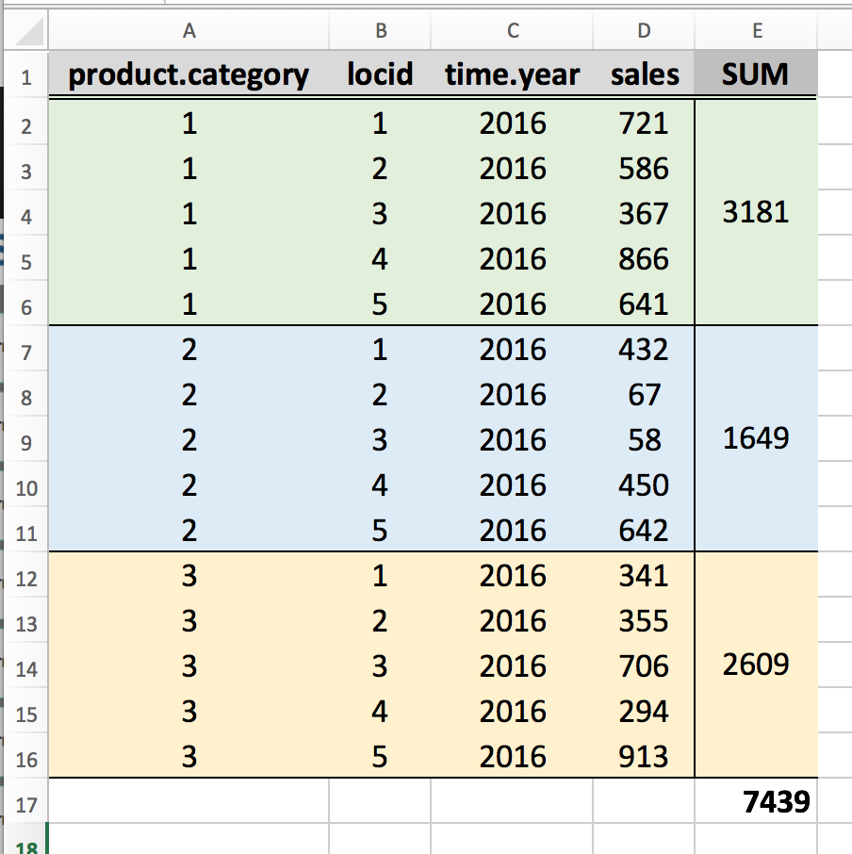
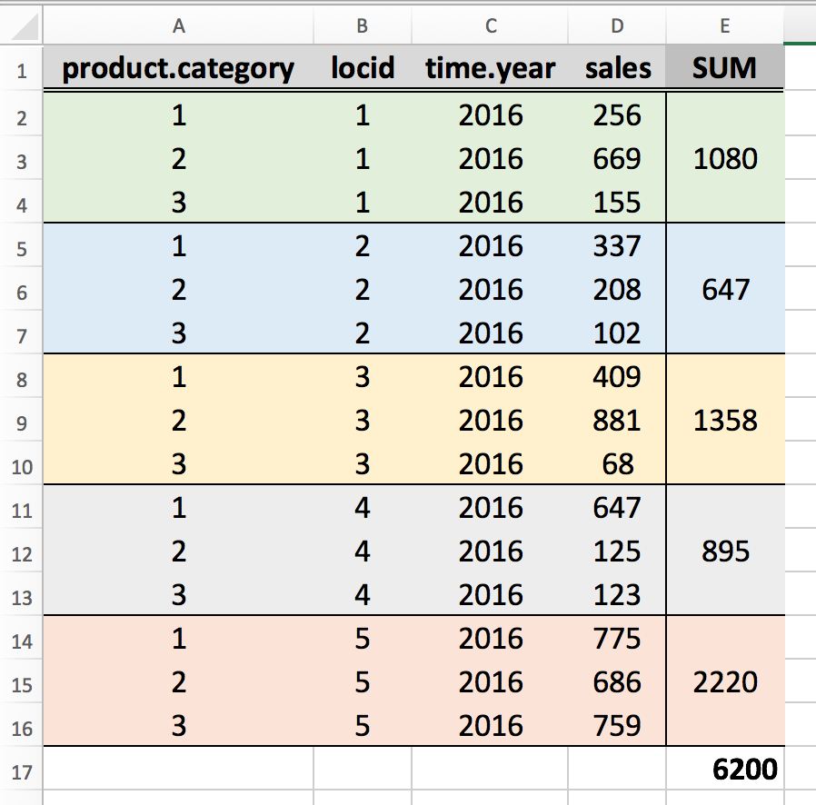
OLAP queries
Combination of SQL and spreadsheets
SELECT
product.category, SUM(sales)
FROM sales, product, time
WHERE time.year=2016 AND sales.timeid=time.timeid AND sales.prodid=product.prodid
GROUP BY product.category
locid
Notes:
What kind of queries do we want to run over this data?
OLAP queries (Online analytical Processing):
Borrow ideas from spreadsheets, and introduce these ideas in a scalable environment. Can be thought of as spreadsheet functionality (aggregates) expressed with SQL over relational databases.
(That’s why original papers in the area explained what language primitives SQL needs to support, for example, cross-tabulation)

Slide 17
OLAP queries (2)
Combination of SQL and spreadsheets
Key operation: Aggregations & group by
Find total sales
Find total sales for each city/state/location/category/…
Find top-5 products ranked by average sales
…
Notes:
Key operation – aggregates and group bys

Slide 18
Examples of OLAP
Comparisons (this period v.s. last period)
Show me the sales per region for this year and compare it to that of the previous year to identify discrepancies
Multidimensional ratios (percent to total)
Show me the contribution to weekly profit made by all items sold in the northeast stores between may 1 and may 7
Ranking and statistical profiles (top N/bottom N)
Show me sales, profit and average call volume per day for my 10 most profitable salespeople
Custom consolidation (market segments, ad hoc groups)
Show me an abbreviated income statement by quarter for the last four quarters for my northeast region operations

Slide 19
OLAP queries (3)
Roll-up: Aggregation at different levels
E.g., given total sales by city, roll-up to get sales by state
<locid, city, state, country>
SELECT city, state, SUM(sales)
FROM sales, locations
WHERE sales.locid=locations.locid
GROUP BY ROLLUP(state,city)
country
state
city
STATE CITY SUM(sales)
------ ------ -----------
NY New York 43324
NY Albany 6343
NY Buffalo 5535
NY 55202
CA Berkeley 44200
CA Davis 553
CA 44753
99955
Notes:
OLAP extends SQL such that USER can express his information needs easily, and the query engine can also further optimize.
ROLL-UP command instructs the query engine to compute aggregate results based on a SET of dimensions, but also on subsets of these dimensions, on a particular order!
We are not only interested for the fully-grouped pairs per state+city, but also on the group-by per state, and eventually, without group-by, i.e., with only the SUM

Slide 20
OLAP queries (4)
Roll-up: Aggregation at different levels
E.g., given total sales by city, roll-up to get sales by state
Drill-down: Inverse of roll-up
E.g., given total sales by state, drill-down to get total sales by city, by product, by quarter, …
Pivoting: Aggregation on selected dimensions
Result: cross-tabulation
E.g., pivoting on Location and Time:
country
state
city
Location
1 2 Total
1
30 | 44 | 74
52 | 113 | 165
55 | 442 | 497
137 | 599 | 736
Time
2
3
Total
Notes:
Drill down is inverse of roll-up. Rollup goes from more detailed group-bys to less-detailed group-bys, drill-down, goes from less-detailed to more-detailed!
Pivoting: enable user to choose the selected dimensions for the aggregation. Say, I want to find out which are the most profitable stores, throughout the year. I am not interested on the products per se. I only want to see sales per store, aggregated per time of the year!
Cross-tabulation is similar to a spreadsheet, with sums.

Slide 21
Comparison with SQL queries
Cross-tabulation obtained by pivoting can be computed using a collection of SQL queries
Q1: SELECT SUM(S.sales) FROM sales S, times T, locations L WHERE S.timeid=T.timeid AND S.locid=L.locid
Q2: SELECT SUM(S.sales) FROM sales S, times T WHERE S.timeid=T.timeid GROUP BY T.year
Q3: SELECT SUM(S.sales) FROM sales S, locations L WHERE S.locid=L.locid GROUP BY L.state
State
IL CA Total
07
30 | 44 | 74
52 | 113 | 165
55 | 442 | 497
137 | 599 | 736
Year
08
09
Total
Notes:
Results boil down to many group-by queries. They can be computed using SQL queries, BUT POSSIBLY TOO MANY.
These are simple aggregates. The OLAP dialect releases the user to manually run all these queries.
Example with pivoting/cross-tabulation

Slide 22
OLAP queries (5)
Slicing and dicing: Equality and range selections on one or more dimensions
date
product
store
05.01.17 < date < 16.01.17
Notes:
Slicing: Set values on a couple of dimensions.
Dicing: when we set value ranges on many dimensions, we essentially create dices (rectangles).
Figures taken from:
http://www.cs.bu.edu/fac/gkollios/ada05/LectNotes/lect20-05.ppt

Slide 23
The CUBE operator
k dimensions → 2^{k} possible SQL GROUP BY queries
10 dimensions → 1024 queries!
Cube operator: compute all combinations
Oracle syntax: modify GROUP BY clause:
GROUP BY CUBE(prodid,locid,timeid)
Alternative syntax: CUBE BY
Notes:
Too many possible GROUP BY dimensions!
The cube operator: computes and displays all these aggregates. Supported by oracle and many others.
Example:
GROUP BY CUBE(prodid,locid,timeid)
→ will get results for the following queries:
group by NONE
group by prodid
group by locid
group by timeid
group by prodid, locid
group by prodid, timeid
group by prodid, locid, timeid
group by locid, timeid

Slide 24
The CUBE operator (2)
Cube operator: compute all combinations
Equivalent to aggregating sales on all eight subsets of the set (prodid, locid, timeid)
Each group corresponds to an SQL query: SELECT SUM(S.sales) FROM sales S GROUP BY grouping-list
Heavy optimizations possible
Overlapping of work
Sequential reading
Why CUBE?
Why not individual queries?
Notes:
Cube operator is equivalent to 8 group by queries!
But why cube? Why not just run 8 individual group by queries?
* Recognizing the commonalities between the queries enables more efficient, coordinated computation of the set of queries

Slide 25
Relational View of Data Cube
Store Product_key sum(amount)
1 1 454
1 4 925
2 1 468
2 2 800
3 1 296
3 3 240
4 1 625
4 3 240
4 4 745
1 ALL 1379
2 ALL 1268
3 ALL 536
4 ALL 1937
ALL 1 1870
ALL 2 800
ALL 3 780
ALL 4 1670
ALL ALL 5120
SELECT LOCATION.store, SALES.product_key, SUM (amount)
FROM SALES, LOCATION
WHERE SALES.location_key=LOCATION.location_key
CUBE BY SALES.product_key, LOCATION.store

Slide 26
Data Cube: Multidimensional View
Quarter
Total annual sales
of DVDs in America
1Qtr
2Qtr
3Qtr
4Qtr
sum
Product
DVD
PC
America
VCR
sum
Region
Europe
Asia
sum
ALL,ALL,ALL

Slide 27
Cube: Computing “super-aggregates”
Quarter
Total annual sales
of DVDs in America
1Qtr
2Qtr
3Qtr
4Qtr
sum
Product
DVD
PC
America
VCR
sum
Region
Europe
Asia
sum
ALL, 1Qtr, ALL
PC,ALL,ALL
ALL,ALL,ALL
Super-aggregate: Field absent from GROUP BY clause
in a query used to build a cube cell => ‘ALL’

Slide 28
Cube: Computing “super-aggregates”
What’s the type of super-aggregate to compute?
COUNT, MIN, MAX, SUM: Compute directly from other cells
AVG(): Keep track of SUM, COUNT to compute from other cells
Median, Rank: Must examine entire dataset
Notes:
Original cube work: Try to minimize “amount of storage necessary to compute the super-aggregate”
Modern day: Additional optimization goal -> Find a parallelizable way to compute the super-aggregate

Slide 29
Optimizations: Bitmap Indexes
Indexing crucial for performance
Bitmap indexes
Bit vectors:
1 bit for each
possible value.
Many queries can
be answered using
bit-vector ops!
Why is this faster?
gen
1 0
1 0
0 1
1 0
custid | name | gen | rating
114 | Joe | M | 3
113 | Sam | M | 5
115 | Sue | F | 1
118 | John | M | 4
rating
00100
00001
10000
00010
Notes:
How to make these aggregation queries faster? By using Indexes!
Remember bitmap encoding in column stores? Now we build an index, i.e., we extract an encoded column that can be loaded by itself. We can execute the counting directly on the encoded/compressed representations. E.g., I want to count the number of males, or I want to compute the number of males that highly ranked a particular product, I can do this on the encoded representation directly.
OR I want to compute the number of persons that highly ranked this product, GROUP by gender.
Benefits:
bitmap indexes more compact than traditional B+tree indexes, compressible
bitwise operations, very efficient! E.g., count the number of males that gave a rating = 2.
Consider example with: gender=M and Rating<=2. How will it be answered?

Slide 30
Optimizations: Join Indexes
Consider Sales Products Times Locations
Join index: compute join and store [s,p,t,l]
s, p, t, l: record ids in Sales, Products, Times, Locations
Problem: Number of join indexes grows rapidly
Alternative
For each dimension table with column c, compute [c,s]
Include selection attributes inside the index!
Join-merge the indexes at query time
Notes:
Show example at blackboard
Simple join index: Execute the join and store record ids. WHERE clauses considered → cannot reuse index with different where clause. Number of join indexes explodes, because of different join predicates and different filters
Alternative: Try to satisfy each join/where clause individually. Build an index for each join:
select sum(sales) from sales where category=”shoes” and sales.prodid=products.prodid and sales.locid=locations.locid group by locations.state
build an index containing <sales.saleid, products.category>, and an index containing <sales.saleid, locations.state>
“join-merge the indexes” == intersect them. Can be done efficiently via bitmaps

Slide 31
Optimizations: Star Join
Apply filters on dimensions during hashtable creation
Get qualifying keys from each dimension, and use them to prune Fact table => Reduce fact tuples used in joins
Notes:
In a star join plan, the database server pushes down keys from a dimension table to filter the facttable at the same time as it builds the hash table on the dimension table. This dynamic filter onthe fact table reduces the number of rows used in the probe phase of the actual hash joins. In thequery plan shown in Figure 3, keys from two of the hash table builds (from the Location and Timetables) are pushed down to filter the Orders table before the sequence of hash joins is performed.
Hash tables are built first on the Location and Time tables, then on the Customer table. The hashtable created from the Location table contains only the filtered rows of the table that meet thefilter requirements l.region_id = 4. For these filtered rows, the location_id keys (primary keyon Location table) are pushed down (or streamed) in the query processing plan and applied asfilters to the Orders fact table (on the foreign key of Orders table, o.location_id = streamedl.location_id).
Keys are also pushed down from Time hash table build (date_time keys) to filter the Ordersfact table (o.date_time = streamed t.date_time). The application of the push-down filters fromdimension tables help reduce the size of the fact table in all of the subsequent hash joins, sinceonly rows of the Orders table from the appropriate region and corresponds to appropriate timeperiod are selected for further processing. So instead of 100 million rows from the Orders tablefeeding into the first hash join, only 1 million rows are selected from Orders table (1 percent oforiginal size due to combined selectivity from push-down filters).
As this query plan shows, keys from more than one hash table build can be pushed down to filterrows of the fact table. The overall benefit of pushing down keys to filter fact table rows is directlyproportional to the filter selectivity of the dimension table. The optimizer chooses the best numberof push-downs based on cost estimation, such that the work required to perform push-down doesnot outweigh the benefit for applying the push-down filter.
Performance advantages of a star join plan
A star join plan utilizing push-down hash join technology makes hash joins more effective primarilydue to reduction of fact table (probe table) rows early on. The larger the probe table is in a hashjoin, the slower the join is. When hash tables are built, join keys are pushed down and used to filterthe rows of the fact table, and performance improves dramatically. The performance improvementdepends on the selectivity of the filter on the dimension table from which the join keys are pusheddown. If only a few rows are selected from the dimension table so that only a few keys are pusheddown, then rows of the fact table might be reduced proportionally. The actual proportion dependson the distribution of rows with the pushed-down keys in the fact table.

Slide 32


Slide 33
Overview
Introduction
Data warehouses
On-line analytical processing (OLAP)
Views
Top-N queries

Slide 34
Views
Most OLAP queries: aggregate queries
Cube – large collection of aggregate queries
Expensive – precomputation is essential
Views: A key component of warehouses
Evaluate-on-demand
Pre-computed – materialized
Different refresh policies
Notes:
Two types of views: Evaluate-on-demand (aka compute-on-demand) or pre-computed (materialized)

Slide 35
Evaluate-on-demand views
CREATE VIEW RegionalSales (category,sales,state) AS SELECT P.category, S.sales, L.state FROM Products P, Sales S, Locations L WHERE S.pid=P.pid AND S.locid=L.locid
SELECT category,state,SUM(sales) FROM RegionalSales GROUP BY category,state
Notes:
Non-materialized views. View can be defined as such,
This simplifies the SQL query writing process a lot. We write it once, and we can use it in many different queries.
Conceptually, non-materialized views operate as shortcuts. Like adding an alias in unix-style systems.

Slide 36
Evaluate-on-demand views (2)
CREATE VIEW RegionalSales (category,sales,state) AS SELECT P.category, S.sales, L.state FROM Products P, Sales S, Locations L WHERE S.pid=P.pid AND S.locid=L.locid
SELECT category,state,SUM(sales) FROM RegionalSales GROUP BY category,state
Modified query:
SELECT category,state,SUM(sales) FROM (SELECT P.category, S.sales, L.state FROM Products P, Sales S, Locations L WHERE S.pid=P.pid AND S.locid=L.locid)
GROUP BY category,state
Notes:
If view is NOT materialized: Query modification process: replace view with an inner query.
Minor detail: Non materialized views possibly provide the opportunity to the database to perform some additional optimizations, such as query precompilation. But benefits are negligible.

Slide 37
View materialization
Materialized view: A view whose tuples are stored in the database – a virtual table
Efficiency: Fast access, similar to a query cache → enable interactive queries
Indexing: Ability to add indexes on aggregate queries
Reusability: Reuse results across queries/users
But introducing complexity
Data replication → additional space requirements
Maintenance/refreshing
Notes:
If view is materialized: The view behaves as an additional table (it is in fact an additional ‘special’ table!).
This comes with several benefits!
Indexing: “Think of an example with a clustered index”

Slide 38
Issues in view materialization
Which views to materialize - which indexes to build on top of them
How/when to exploit views
Both are application-dependent: expected workload, cost with/without the view, real-time requirements
How to maintain the views up-to-date

Slide 39
View maintenance policies
Immediate view maintenance
Deferred view maintenance
Lazy: update before query
Slower queries, faster updates
Queries still faster than no-view in most cases
Periodic: update at regular intervals
Forced: update after a certain number of updates to the base tables
Fast queries, batch updating
Possibly stale results
Notes:
Different policies for view maintenance.
Before going on, remember that we focus on OLAP queries today. OLAP → infrequent ad-hoc updates, and in many cases are not so important. Typically, can withstand some error!
Immediate view maintenance is what we would expect from an OLTP system. Immediately whenever an update occurs, maintain the view. An option, but too expensive if we are talking about huge datasets. ALSO not necessarily meaningful.
Instead, typically using deferred maintenance.
Lazy updating: update before the query.
Periodic
Forced

Slide 40
Computing Data Cube From Existing Views
Model dependencies among the aggregates:
most detailed “view”
product,store,quarter
can be computed from view (product,store,quarter) by summing-up all quarterly sales
product,quarter
store,quarter
product, store
quarter
product
store
none

Slide 41
Cube building optimizations
Agrawal et al [VLDB96]
Optimize hash/sort-based cube computation:
Smallest-parent
Cache-results
Amortize-scans
Share-sorts
Share-partitions
product,store,quarter
product,quarter
store,quarter
product, store
quarter
product
store
none
Notes:
Smallest-parent: Compute a groupby from the smallest previously computed groupby
Cache-results: Cache in memory the results of a groupby from which other groupbys are computed in order to reduce disk I/O
Amortize-scans: Compute as many groupbys together as possible in memory.
Share-sorts: If you use a sort-based method to compute a groupby, try to share the sorting cost across multiple groupbys
Share-partitions: If you use a hash-based method to compute a groupby, share the partitioning cost across multiple groupbys

Slide 42
Which views to build?
Use some notion of benefit per view
Limit: disk space or maintenance-time
Hanirayan et al SIGMOD’96:
Pick views greedily until space is filled
product,store,quarter
product,quarter
store,quarter
product, store
quarter
product
store
none
Catch: quadratic in the number of views, which is exponential!!!
Notes:
B: benefit
S: some set of views
C(u): cost of view u
We have a candidate view u to potentially include in S.
For each view w that u covers, calculate the cost of computing it using u VERSUS the cost of computing it using the cheapest suitable (i.e., compatible) view in S.
View explosion:
2^n views for n dimensions
Storage-update time explosion
More precomputation does not mean better performance
V. Harinarayan, A. Rajaraman and J. Ullman. Implementing data cubes efficiently. In Proc. ACM SIGMOD Conf., Montreal, 1996.

Slide 43
Overview
Introduction
Data warehouses
On-line analytical processing (OLAP)
Views
Top-N queries

Slide 44
Top-N queries
Examples
Find the 20 most expensive products
Find the 10 products sold most in the USA
Find the 5 cities where products of category “Apparel” are sold most
Key optimization insight
Focus on very few results

Slide 45
Top-N queries (2)
Examples
Find the 10 products with the highest sales in locid=1 and timeid=3
SELECT P.pid, P.pname, S.sales FROM Sales S, Products P WHERE S.pid=P.pid AND S.locid=1 AND S.timeid=3 ORDER BY S.sales DESC OPTIMIZE FOR 10 ROWS
SELECT P.pid, P.pname, S.sales FROM Sales S, Products P WHERE S.pid=P.pid AND S.locid=1 AND S.timeid=3
AND S.sales>c ORDER BY S.sales DESC
Notes:
Optimize for 10 rows : limit 10 in mysql, rownum<=10 in oracle
Finding the cutoff value c is non-trivial -> Histograms and stats do help

Slide 46
Summary
OLAP: Providing decision support for your future managers
Multidimensional data model, typically represented as special db schema
Star, snowflake
Materialize views for fast retrieval of summaries
Keep in mind though: Column stores are changing the picture!!!

